Slide 1
CyberSec Certificate Tracker
The Neighbors
Aayush Gautam, Anuska Pant, Mesbaul Khan, Sabina Adhikari, & Yatin Gupta
Clients: John Romero, Kelly Ragusa

Slide 2





What is your project?
Common portal to manage students, courses, certificates and exams
Expected type of users: 2
User
Admin
Expected scale of product: 5000 records
John Romero and Kelly Ragusa

Slide 3
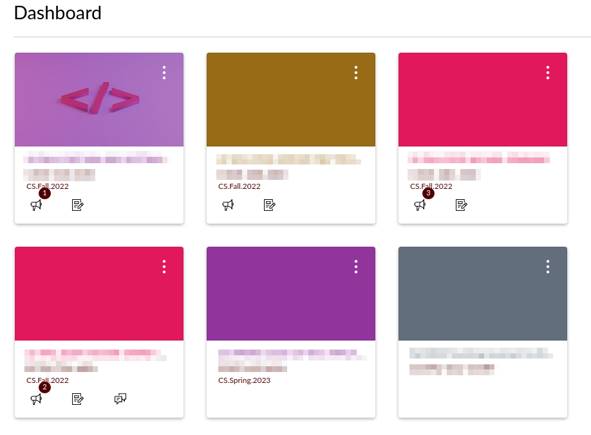

Problem Statement
Different portals
Different csvs
Inconsistent data
Difficult to keep track
Canvas
TEES Edge

Slide 4

Problem Statement
Analytics_enrollment_from_canvas
Canvas User Id
Student Name
Student Email
Listing Name: Course Name
Created At: Course Registration Date
Completed At: Course Completion Data
Different portals
Different csvs
Inconsistent data
Difficult to keep track
Registrants_tees_edge_secplus
Full Name
Email Address
Company Name
Title
Contain only partial information about a student and course
Registrants_tees_edge_netplus

Slide 5
Problem Statement
Different portals
Different csvs
Inconsistent data
Difficult to keep track
Different Naming Conventions
Record is present in Canvas, but no corresponding record in TEES edge and vice versa

Slide 6
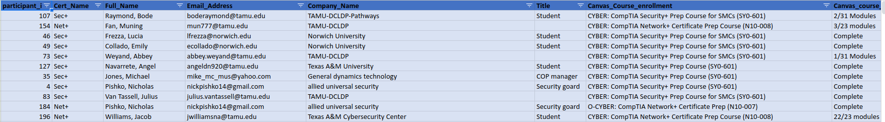
Problem Statement
Not Scalable
Difficulty in searching
Error prone updates
No check for consistency
Different portals
Different csvs
Inconsistent data
Difficult to keep track
Manually Unifying the data in a large Spreadsheet

Slide 7
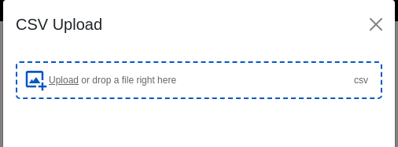
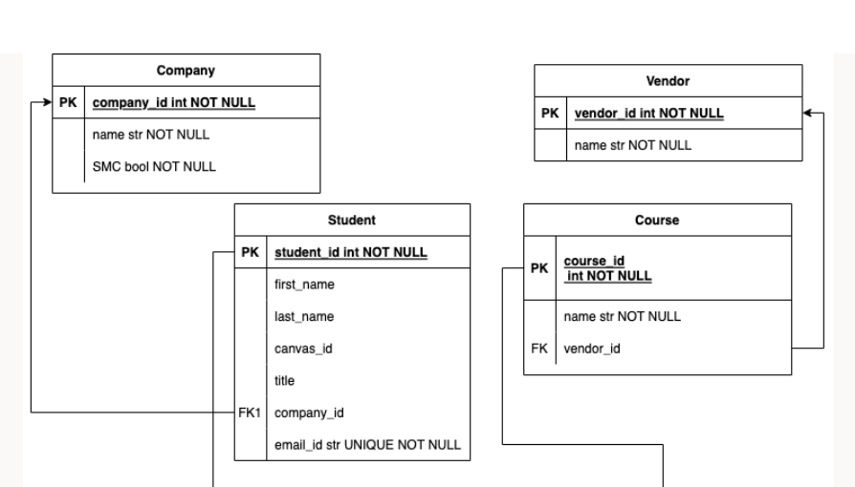
Our Solution
Analytics_enrollment_from_canvas
Registrants_tees_edge_secplus
Registrants_tees_edge_netplus
Unify the data
CSV Upload
Manual Entry
View the data
Create and Update (Admin only)
Search
Autocomplete
Sort
Edit and Delete
Export CSV

Slide 8
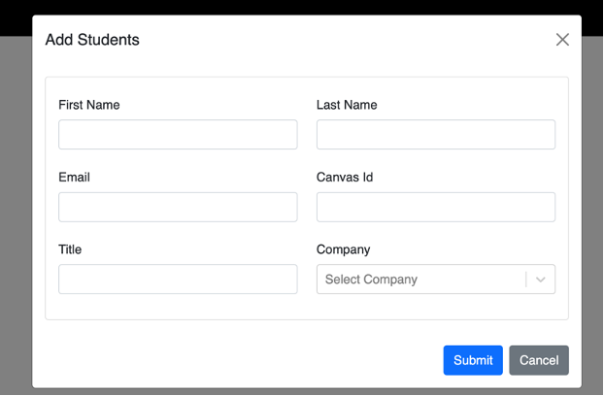
Our Solution
Unify the data
CSV Upload
Manual Entry
View the data
Create and Update (Admin only)
Search
Autocomplete
Sort
Edit and Delete
Export CSV

Slide 9
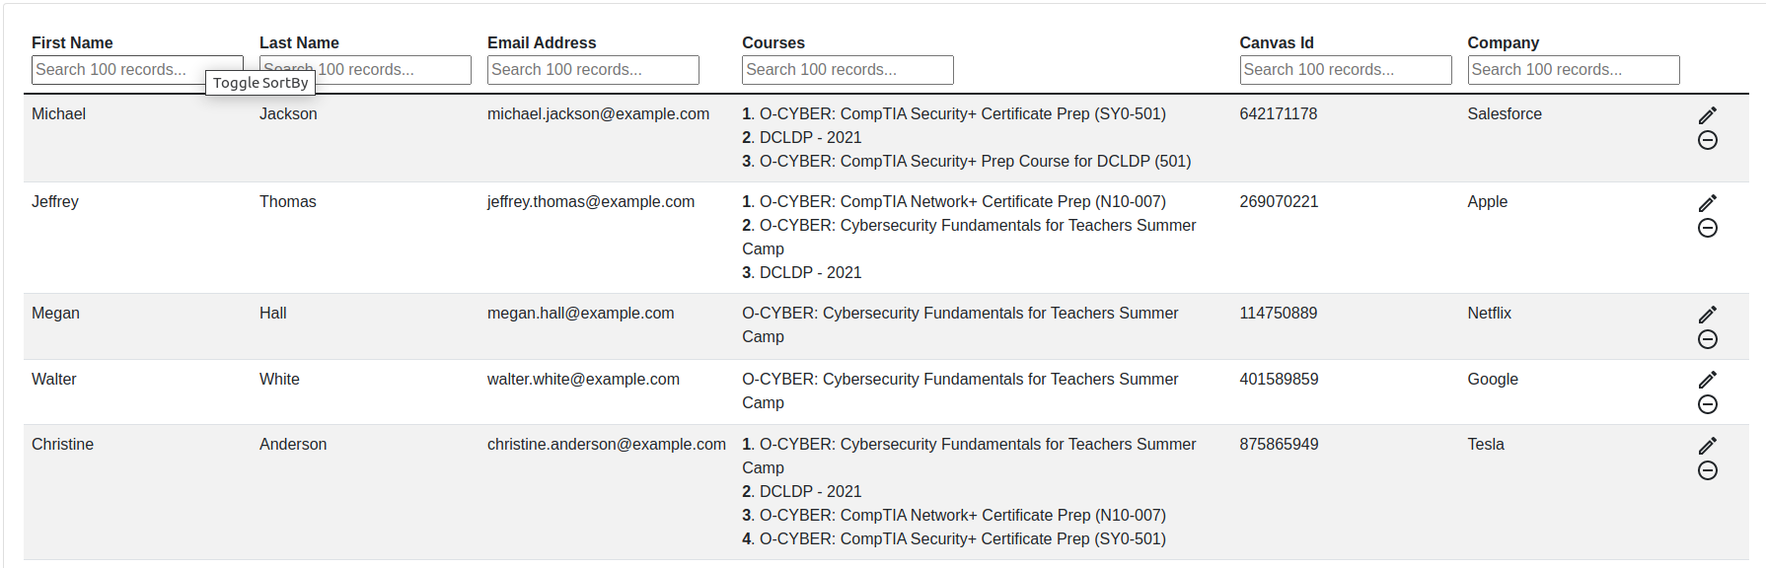
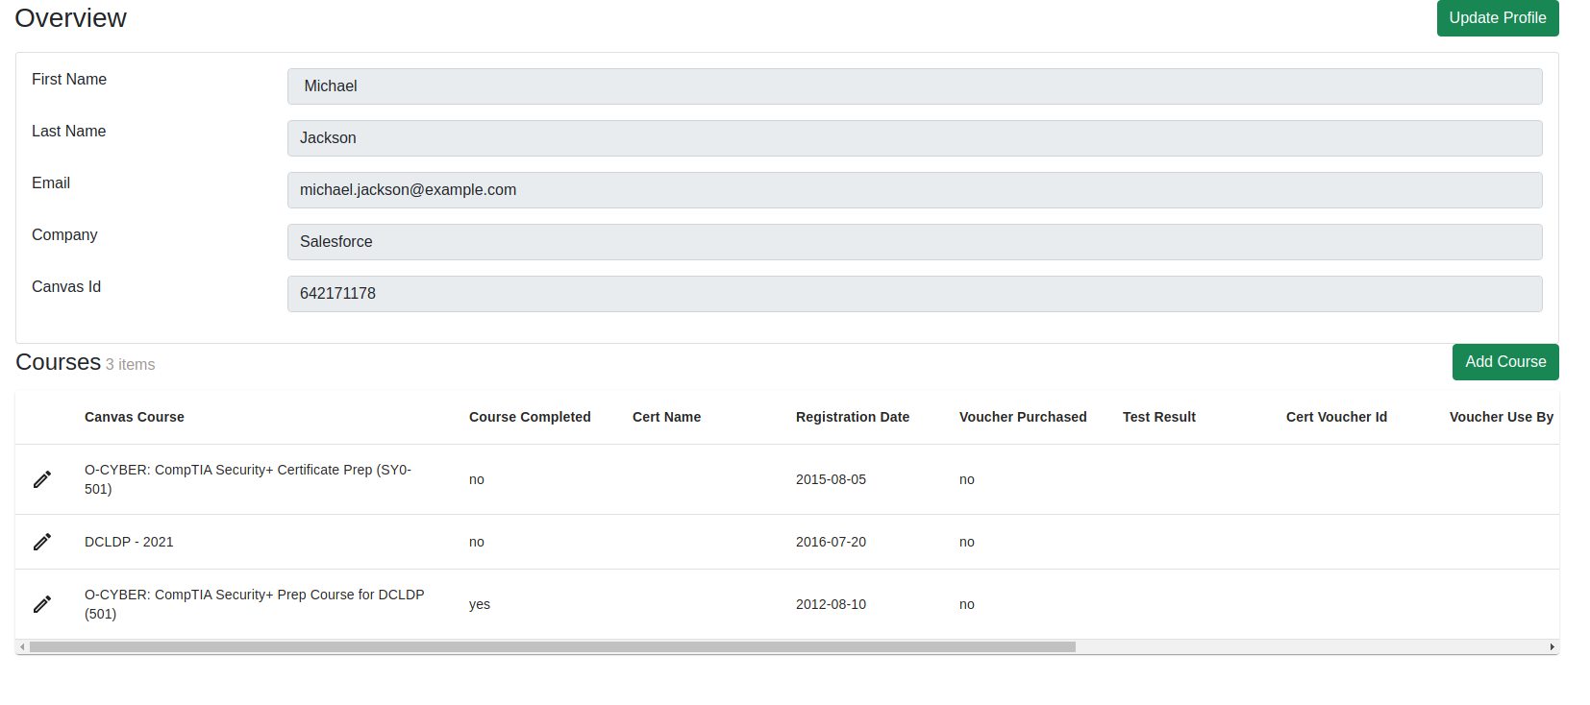
Our Solution
Unify the data
View the data
Dashboard
Student Profile
Course Information, etc
Create and Update (Admin only)
Search
Autocomplete
Sort
Edit and Delete
Export CSV
Dashboard
Student Profile

Slide 10
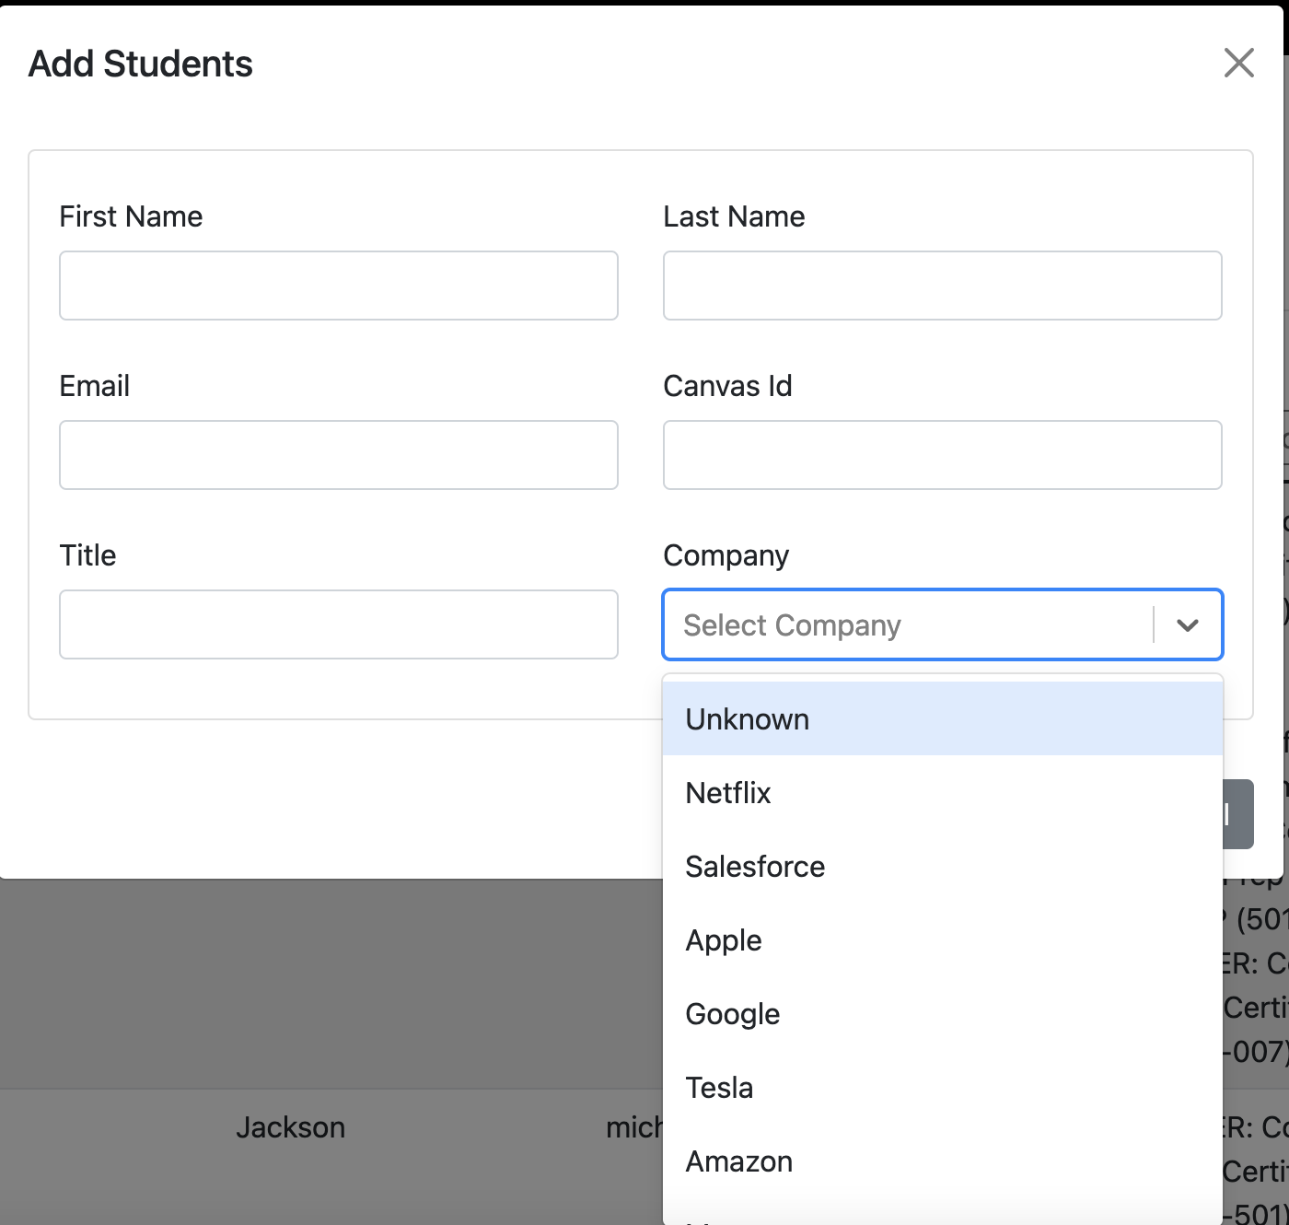
Our Solution
Unify the data
View the data
Create and Update (Admin only)
Forms
Dropdowns for Consistency
Search
Autocomplete
Sort
Edit and Delete
Export CSV

Slide 11
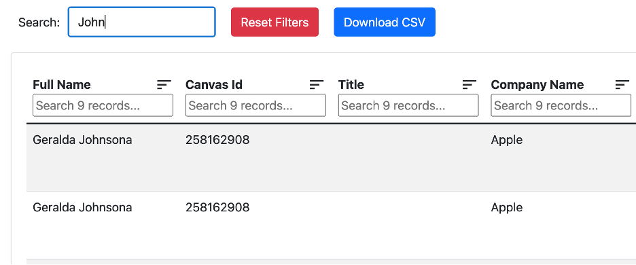
Our Solution
Unify the data
View the data
Create and Update (Admin only)
Search
Search By Name
Search By Company
Search By Email
Autocomplete
Sort
Edit and Delete
Export CSV

Slide 12
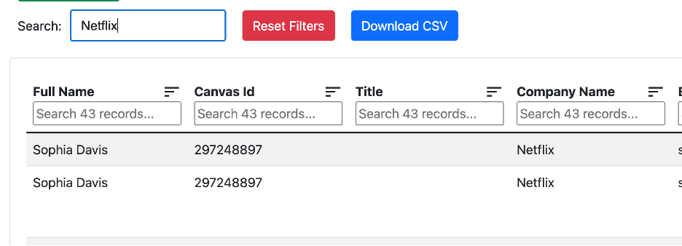
Our Solution
Unify the data
View the data
Create and Update (Admin only)
Search
Search By Name
Search By Company
Search By Email
Autocomplete
Sort
Edit and Delete
Export CSV

Slide 13
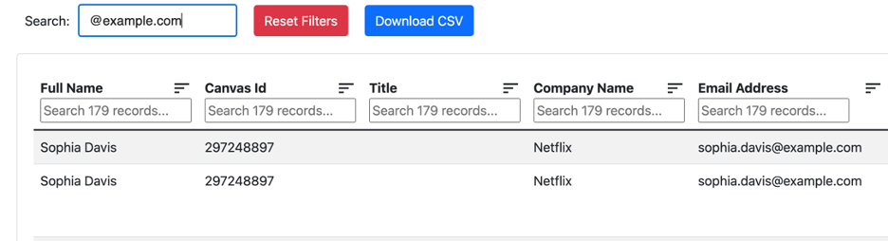
Our Solution
Unify the data
View the data
Create and Update (Admin only)
Search
Search By Name
Search By Company
Search By Email
Autocomplete
Sort
Edit and Delete
Export CSV

Slide 14
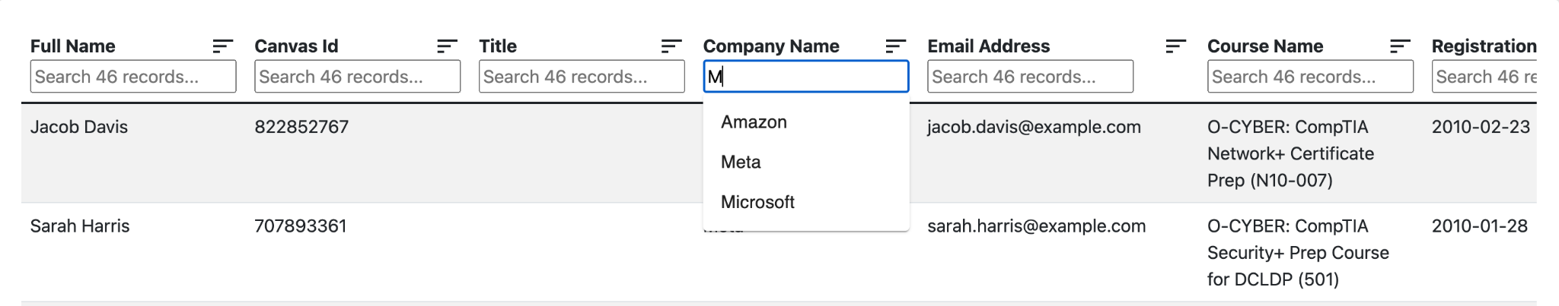
Our Solution
Unify the data
View the data
Create and Update (Admin only)
Search
Autocomplete
Sort
Edit and Delete
Export CSV

Slide 15
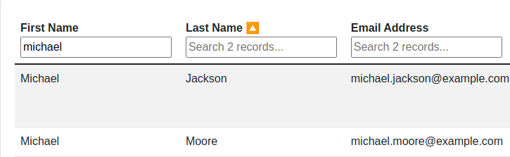
Our Solution
Unify the data
View the data
Create and Update (Admin only)
Search
Autocomplete
Sort
Edit and Delete
Export CSV
Sorting

Slide 16
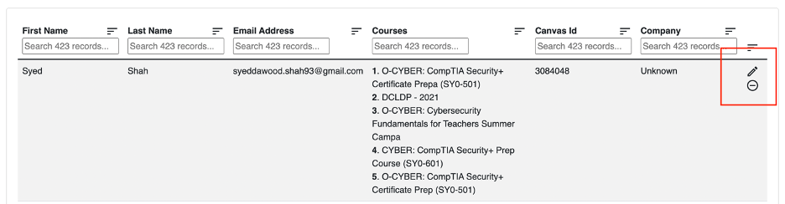
Our Solution
Unify the data
View the data
Create and Update (Admin only)
Search
Autocomplete
Sort
Edit and Delete
Export CSV

Slide 17
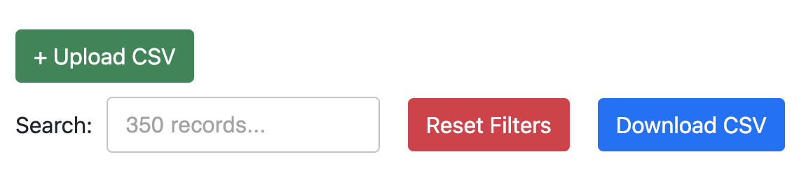
Our Solution
Unify the data
View the data
Create and Update (Admin only)
Search
Autocomplete
Sort
Edit and Delete
Export CSV

Slide 18
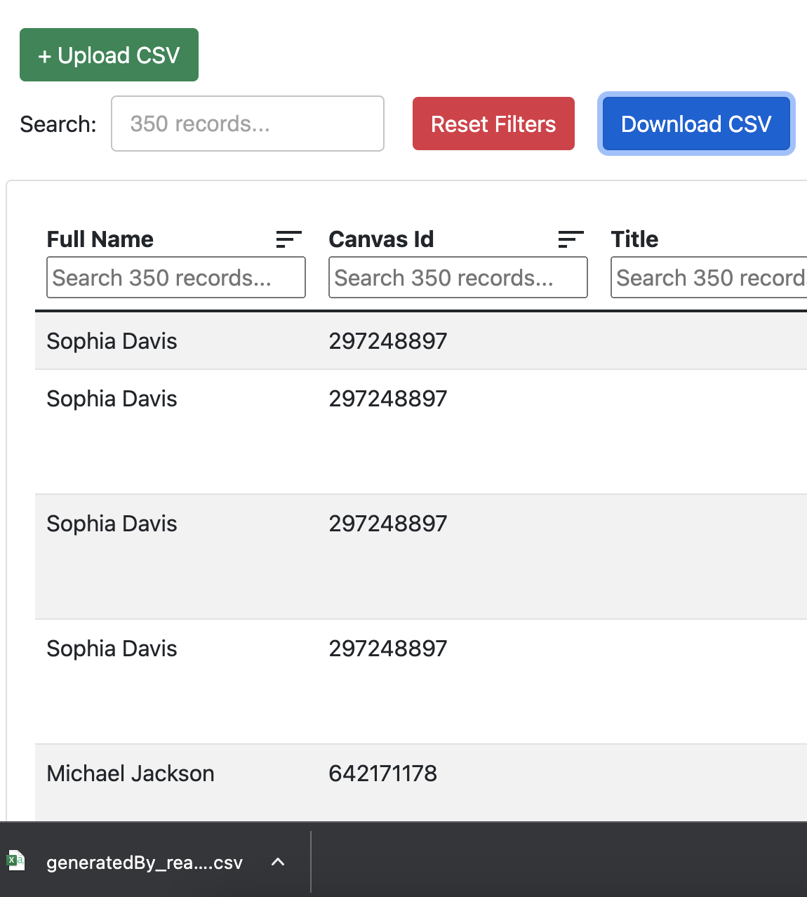
Our Solution
Unify the data
View the data
Create and Update (Admin only)
Search
Autocomplete
Sort
Edit and Delete
Export CSV

Slide 19
Solution
Cybercert tracker app
Login feature
Access control: read-only (user) and read/write (admin)
One upload portal for all csvs
Dashboard to view, search and sort all records
CRUD feature for all
Manual entry for all fields
Only for admins
Student profile for comprehensive overview

Slide 20




Other Functionalities
Interactive Dashboard with Charts
Responsive Design
Deploy in a Private Cluster through Secure VPN
Archive Records

Slide 21
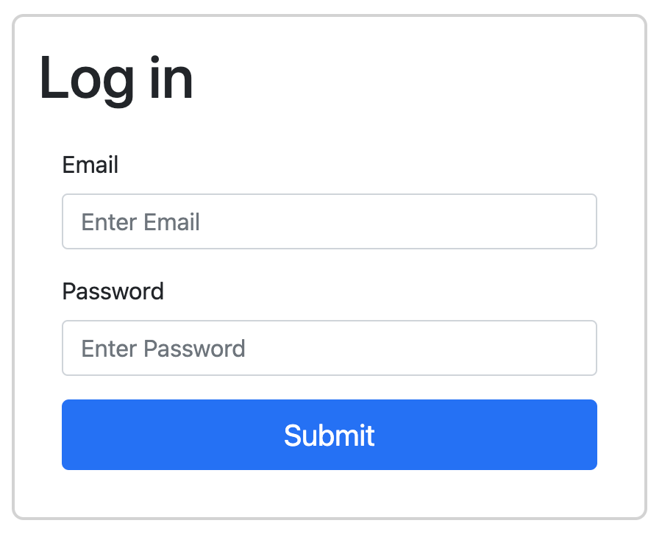
Interactive-App
Cybersecurity Certificate Tracker

Slide 22
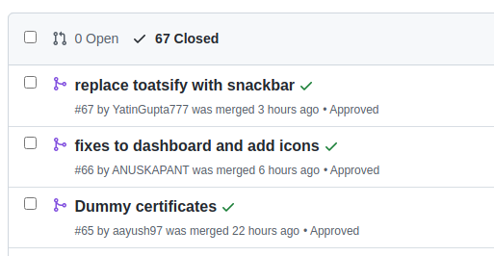
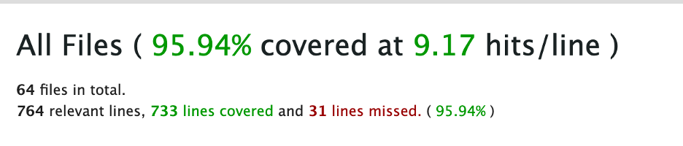


Behind the Scenes
Above 90% test coverage
Github Actions configured to automatically check for errors in pull request

Slide 23
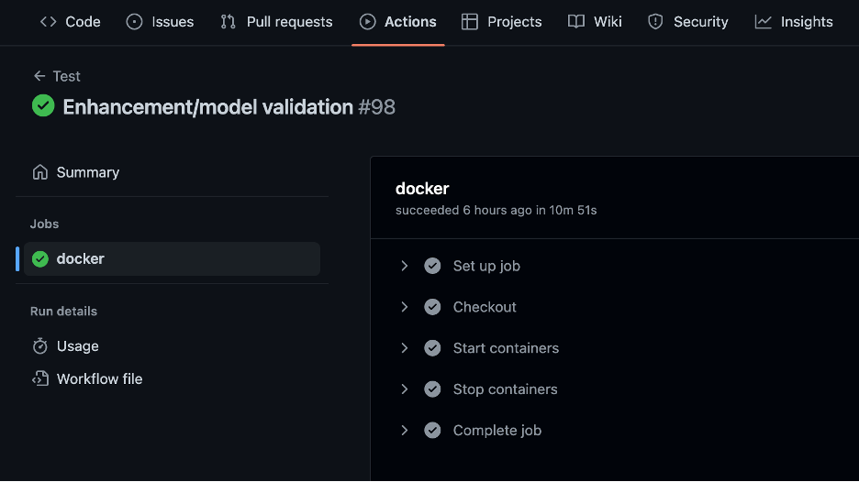
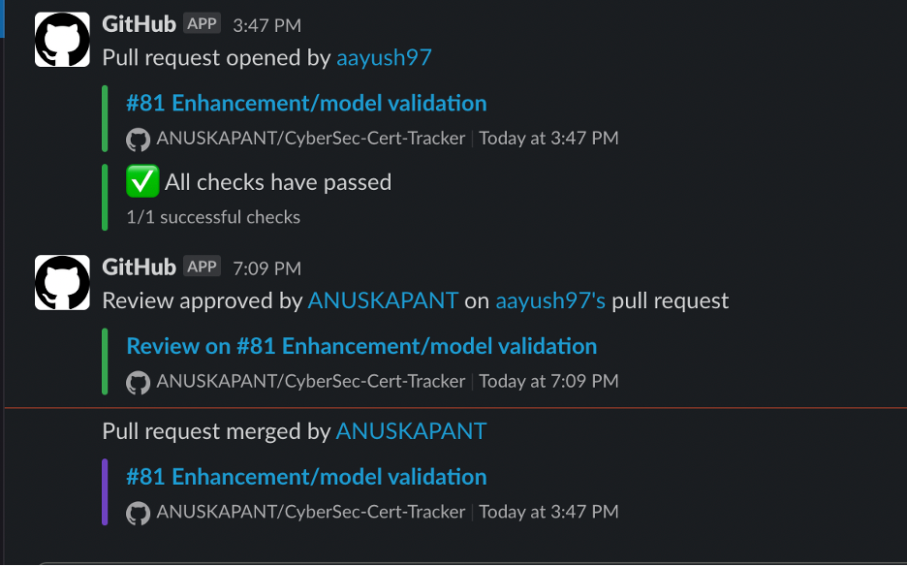

Configuration and Release

Slide 24
Thank You

Slide 25

Functionalities
CSV export
Autocomplete Search for Selected Fields

Slide 26
